Slide 1

Single-cell sequencing Technology
Dr Adam Cribbs

Slide 2
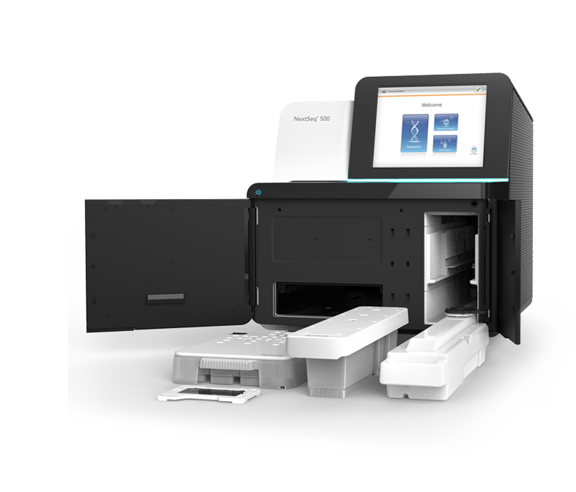
Agenda for this talk
01
Why single-cell
02
Single-cell technology overview
03
Spatial single-cell resolution
04
Quality assessment considerations

Slide 3

Why single-cell?
Understanding heterogeneous tissues
Identification of rare cells
Changes in cellular composition
Dissection of a temporal process across a process

Slide 4
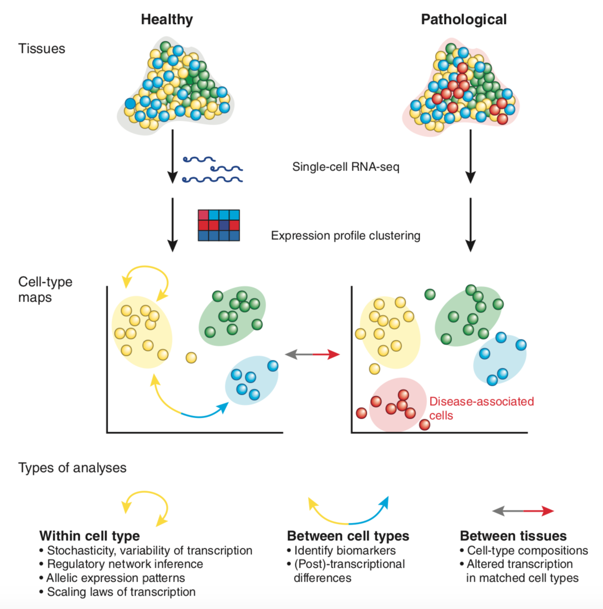
Why single-cell?
(Sandberg, Nature Methods 2014)

Slide 5
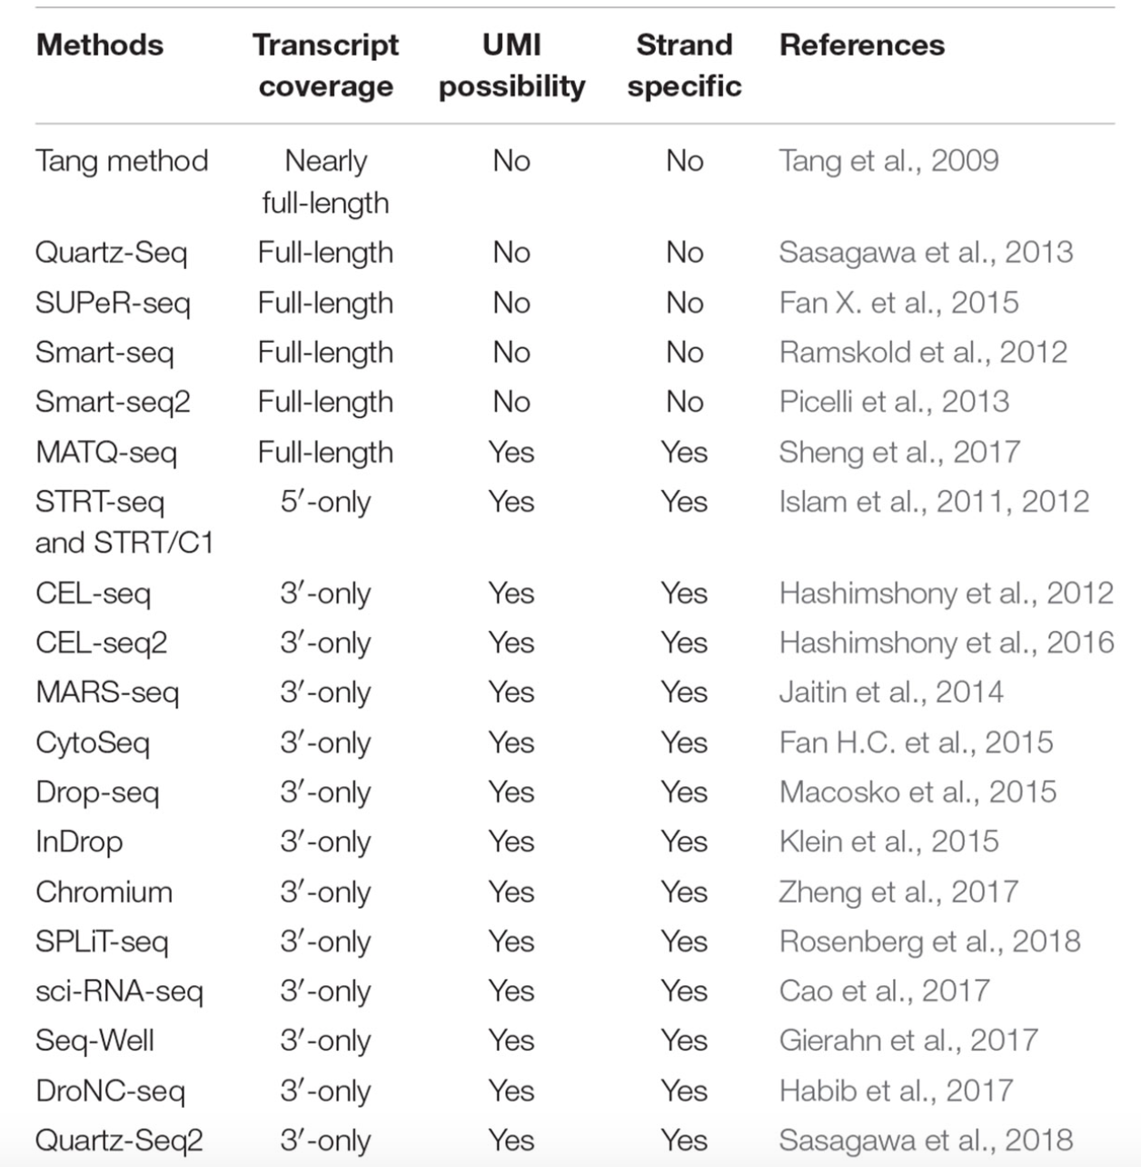
scRNA-seq technologies
New single-cell methods are constantly developed
Can be divided into 3 categories:
Plate based
Droplet based
Circuit based
Chen et al 2019

Slide 6
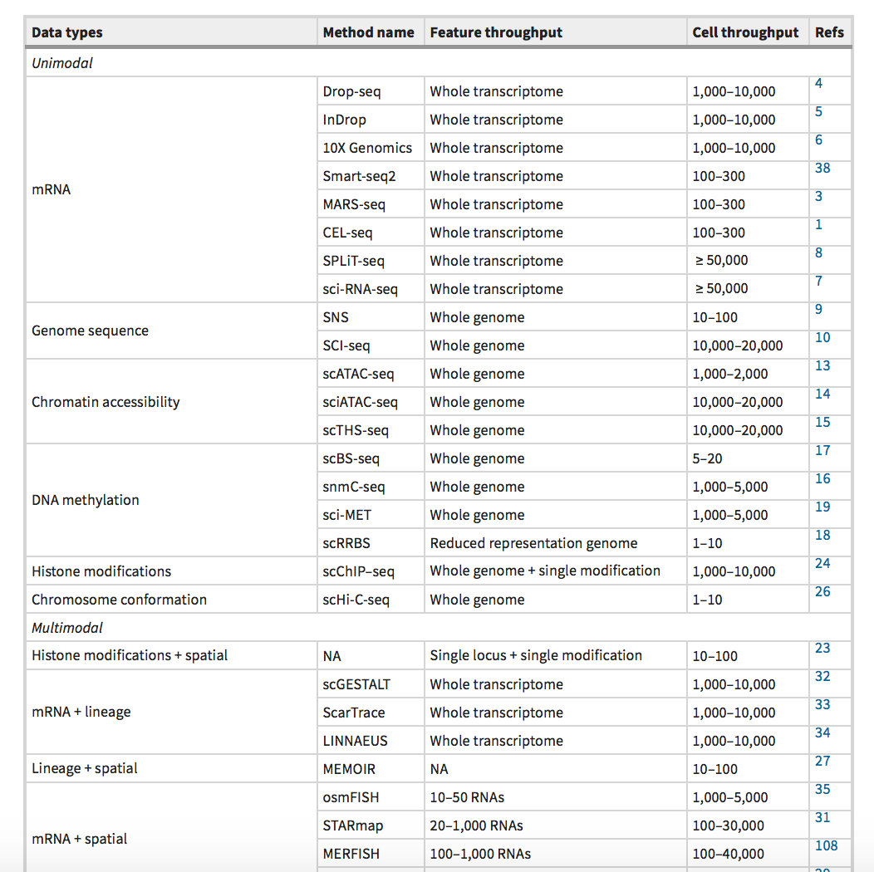
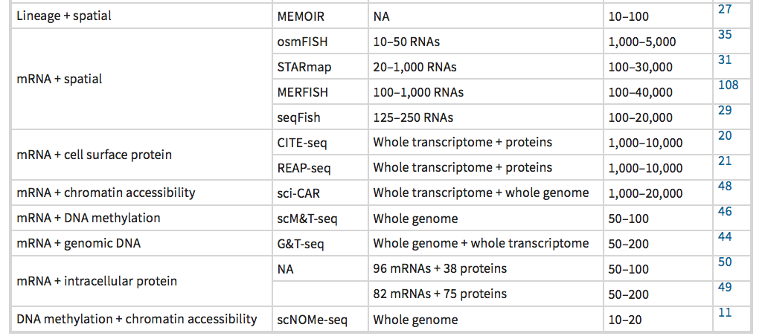
Unimodal and multimodal sc technologies

Slide 7
Concepts underpinning single-cell methods

Slide 8
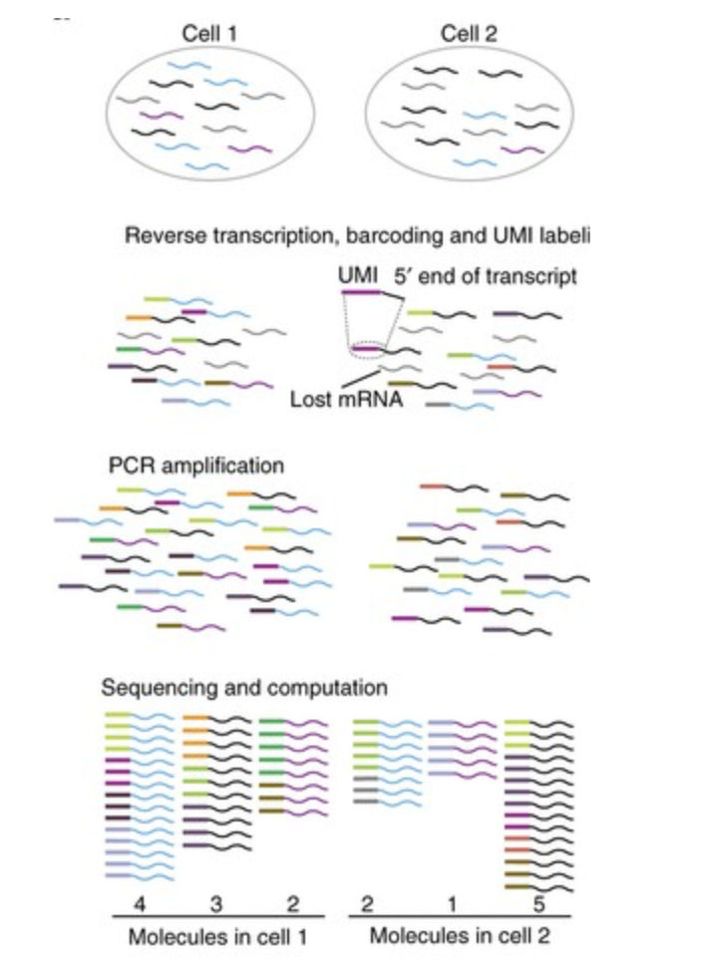
Concepts – UMI and strand specific
Unique Molecular Identifier
Strand specific
F
Read 2
Gene
Read 1
R
Correct PCR duplication effects
Quantify unique mRNAs

Slide 9
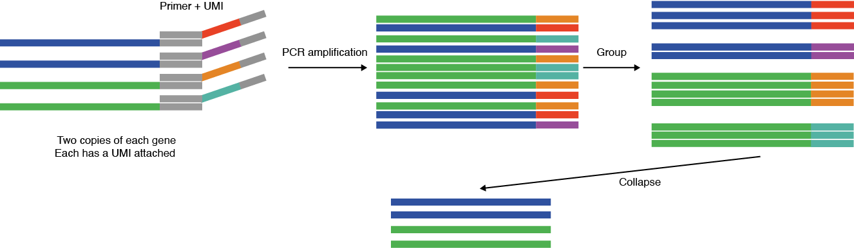
Concepts - What are Unique Molecular Identifiers (UMIs)
Oligonucleotide sequence – 8-12 bp
Added to a DNA sequence before. sequencing to remove PCR duplications.
Complexity of UMIs is greater than the library complexity so that one DNA molecule gets a unique UMI.

Slide 10
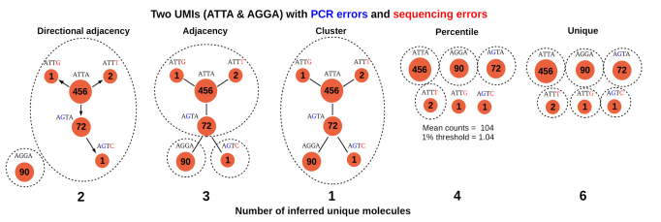
How are UMIs deduplicated in practice?
By using graph theory - mathematical structures used to model pairwise relations between objects
UMI-tools implements directional adjacency model to deduplicate UMIs.
Is it the best approach? … more to come later …

Slide 11
Markov clustering (MCL) UMI de-duplication
The key idea of the MCL-UMI method is to detect UMIs of distance proximity automatically from very complex UMI networks, without relying on UMI counts initially.
A sequenced UMI nearest to other sequenced UMIs is thought to originate from the same UMI cluster, i.e., collapsed into one UMI.
It can disentangle the strongly connected UMI subgraphs from weakly connected UMI subgraphs in a UMI graph, even if there exist some edges between them.

Slide 12
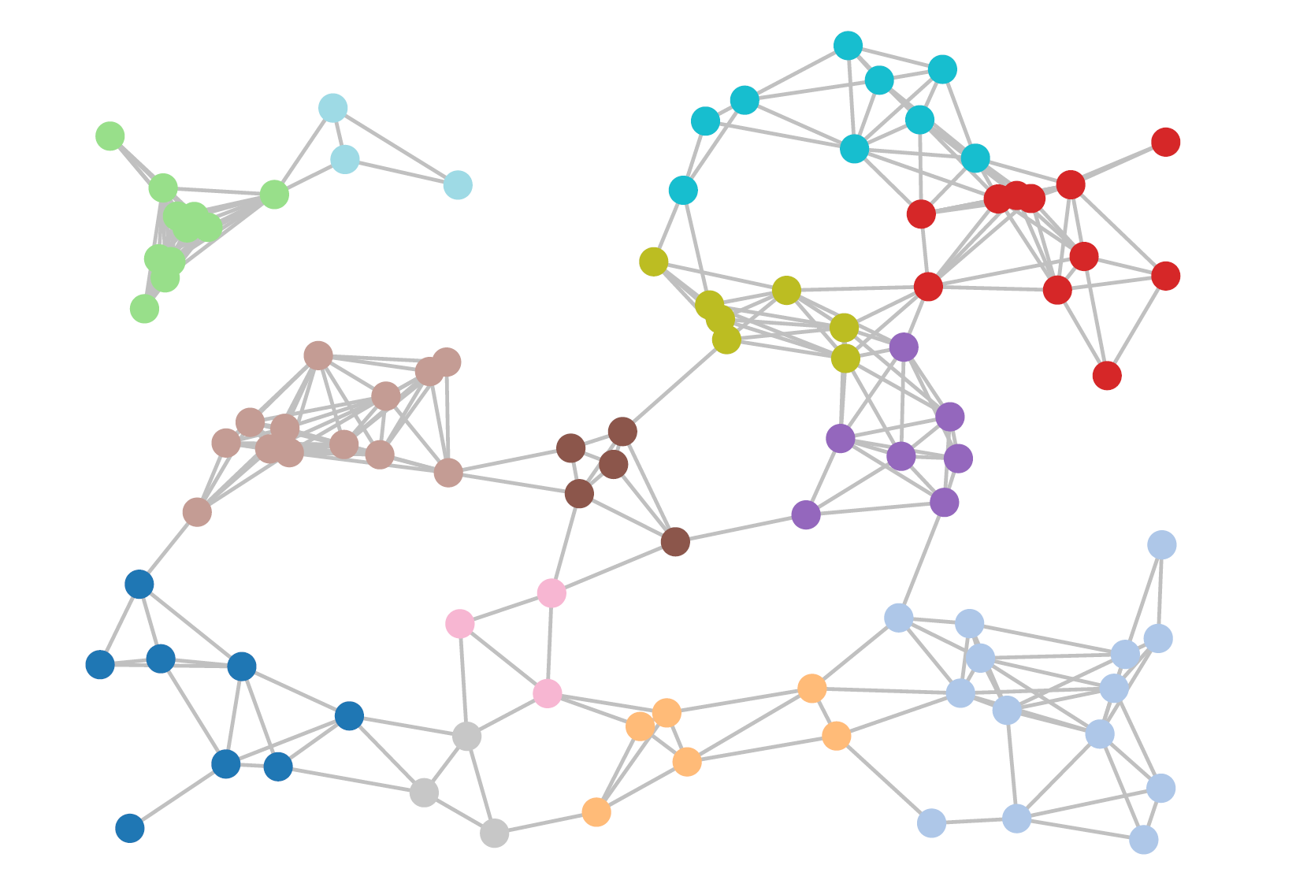
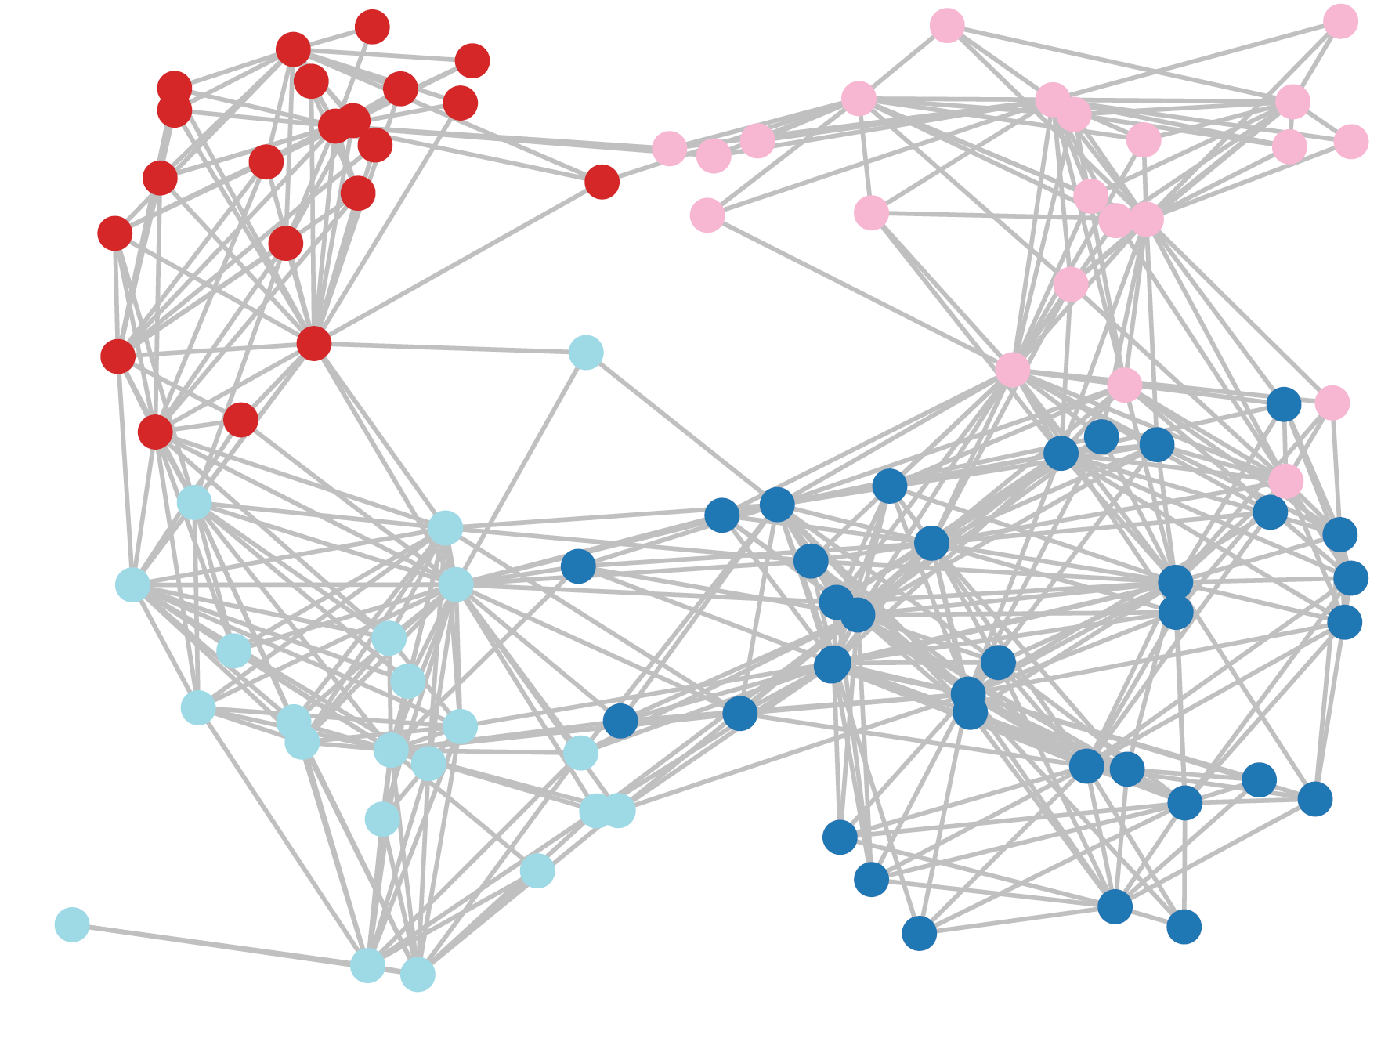
Relatively sparsely distributed UMIs in distance in the UMI graph
Densely distributed UMIs in distance in the UMI graph
Sequenced UMIs (have errors) = 100
UMI = 13
Sequenced UMIs (have errors) = 100
UMI = 4

Slide 13
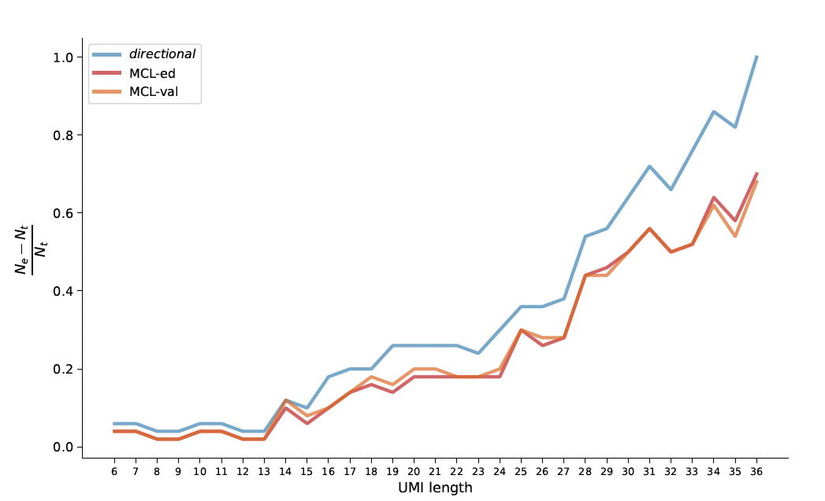
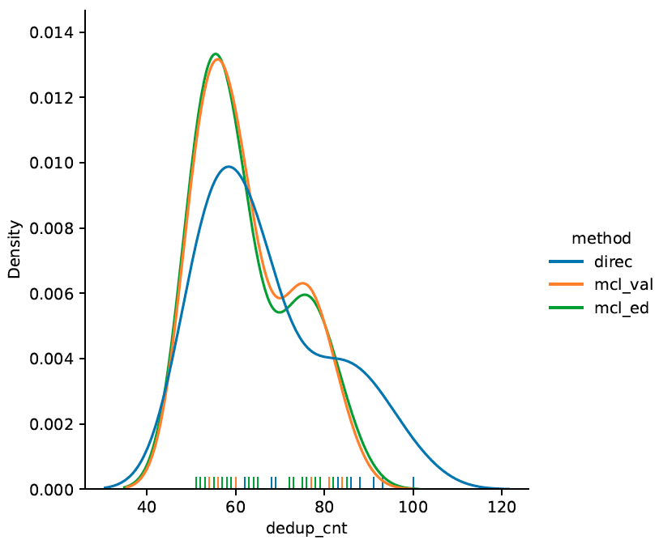
Markov Cluster Algorithm (MCL)-UMI
Improved UMI deduplication with MCL

Slide 14
Concepts - Spike-ins - ERCCs
Added usually for smartseq kit
The ERCC RNA spike-in mix contains exogenous transcripts that differ in length and GC content when compared to the endogenous human transcriptome.
Because the exogenous RNA will be evenly distributed across all GEMs, including GEMs that do not contain cells, the amount of sequencing required will be vastly higher.
ERCCs do not have 5' caps which is relevant given that the template switch reaction is mediated by the cap.
ERCCs have a defined polyA length which does not represent the pool of endogenously expressed transcripts
ERCCs are not associated with cellular proteins such as ribosomal proteins, which can impact the efficiency of RNA to cDNA conversion

Slide 15
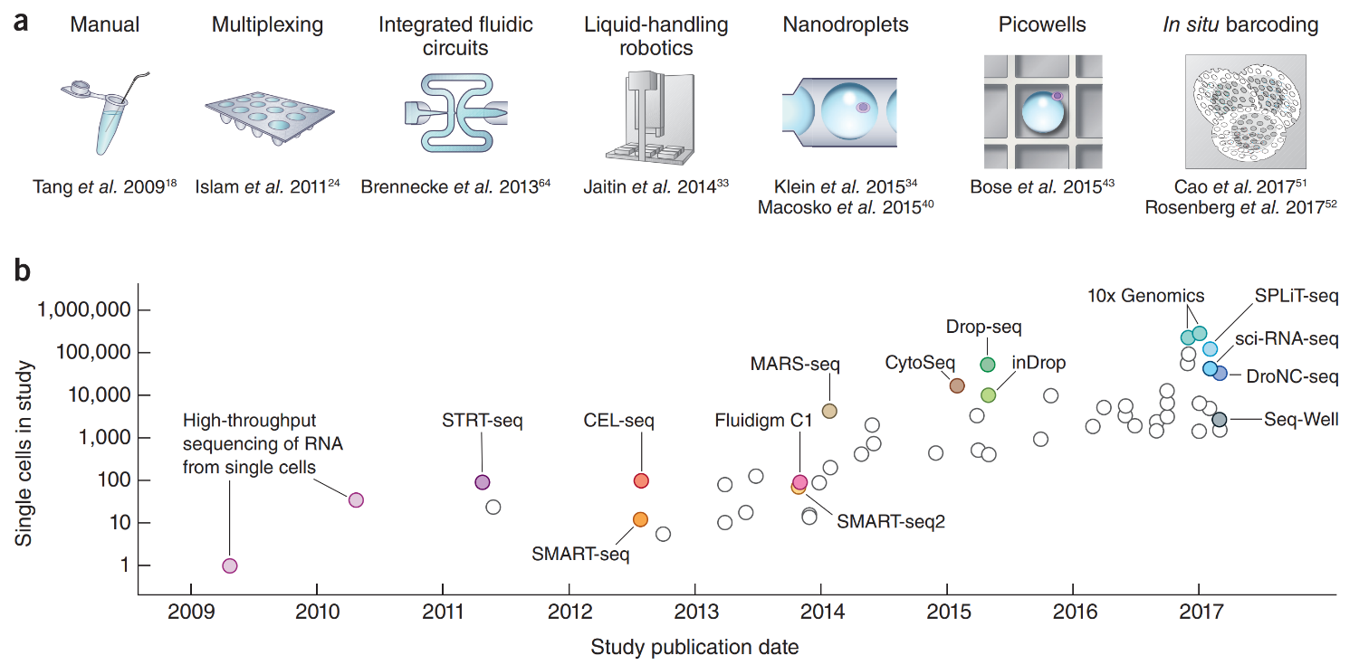
A decade of single-cell technology development
Increase in cell number has led to a decrease in cellular information
HCA white paper 2017

Slide 16
A decade of single-cell technology development
Stuart et al 2019

Slide 17
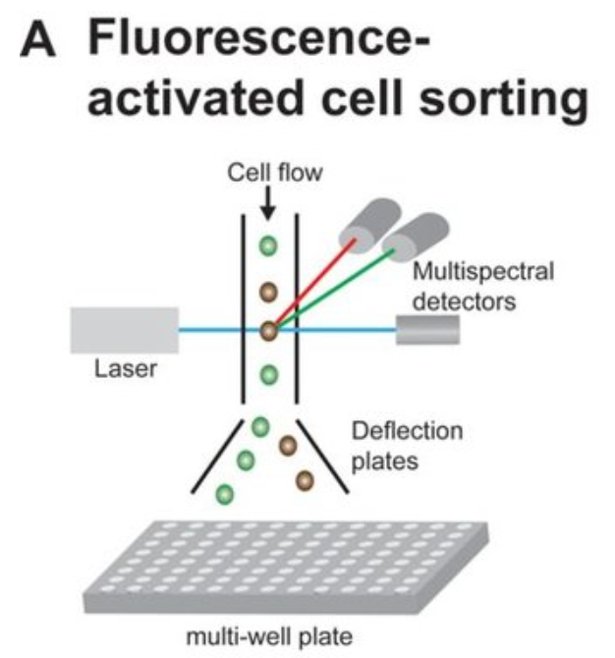
Smart-seq
Full length transcripts
Strand specific
No UMIs
Low throughput 100s of cells
Time consuming
Expensive!!

Slide 18
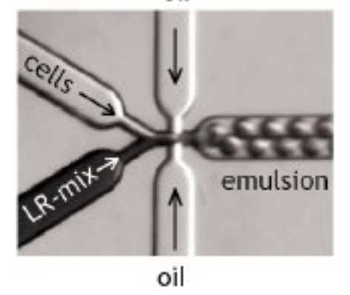

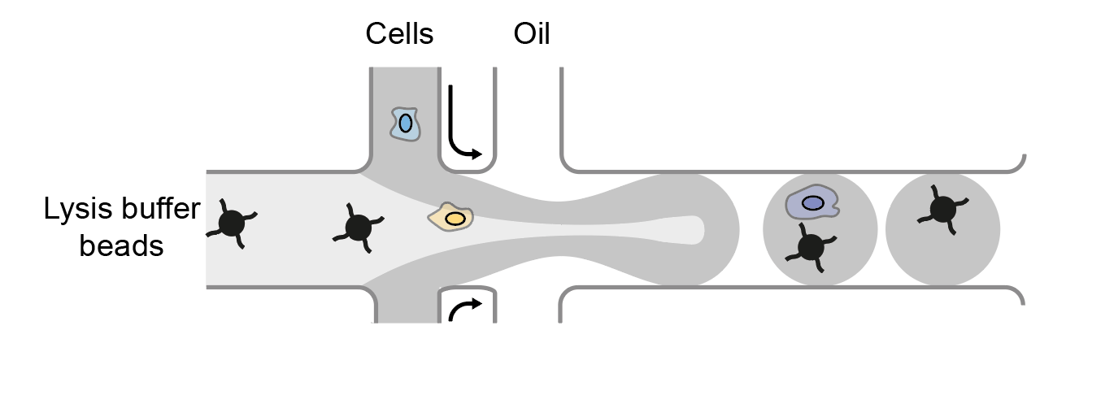
Droplet based single-cell sequencing
InDrops
Drop-seq

Slide 19
Drop-seq
Dolomite bio Nadia

Slide 20
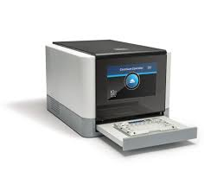
10X genomics

Slide 21
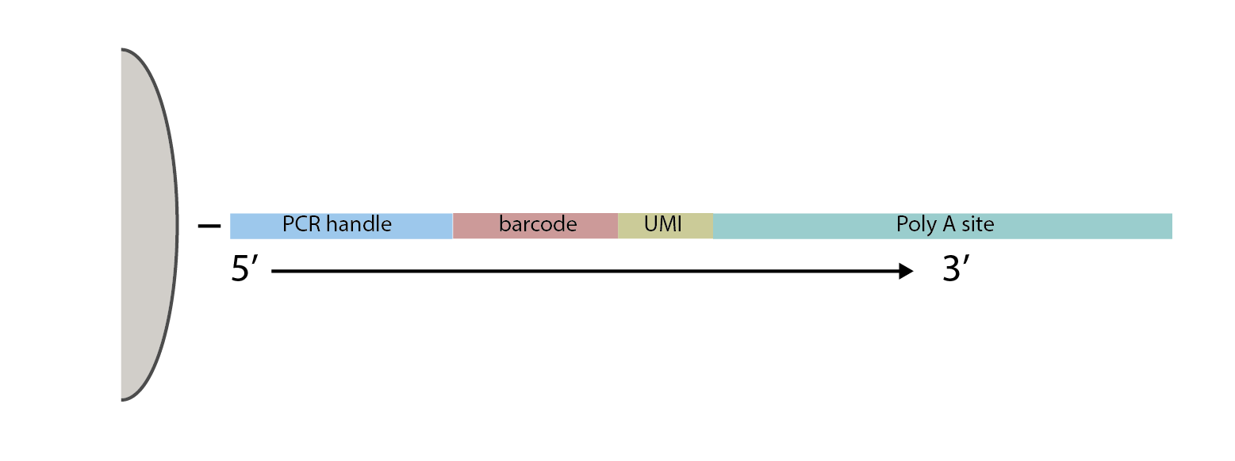
Droplet based single-cell sequencing
Barcode links to a cell
UMI allows PCR duplications to be deduplicated

Slide 22
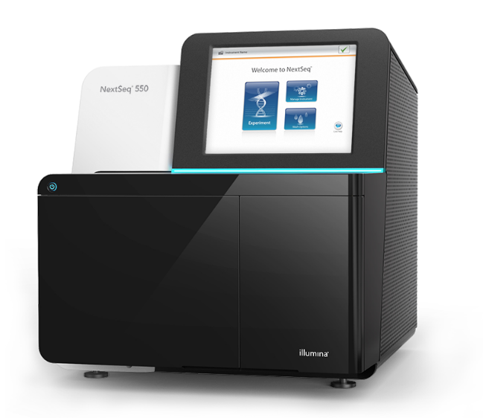
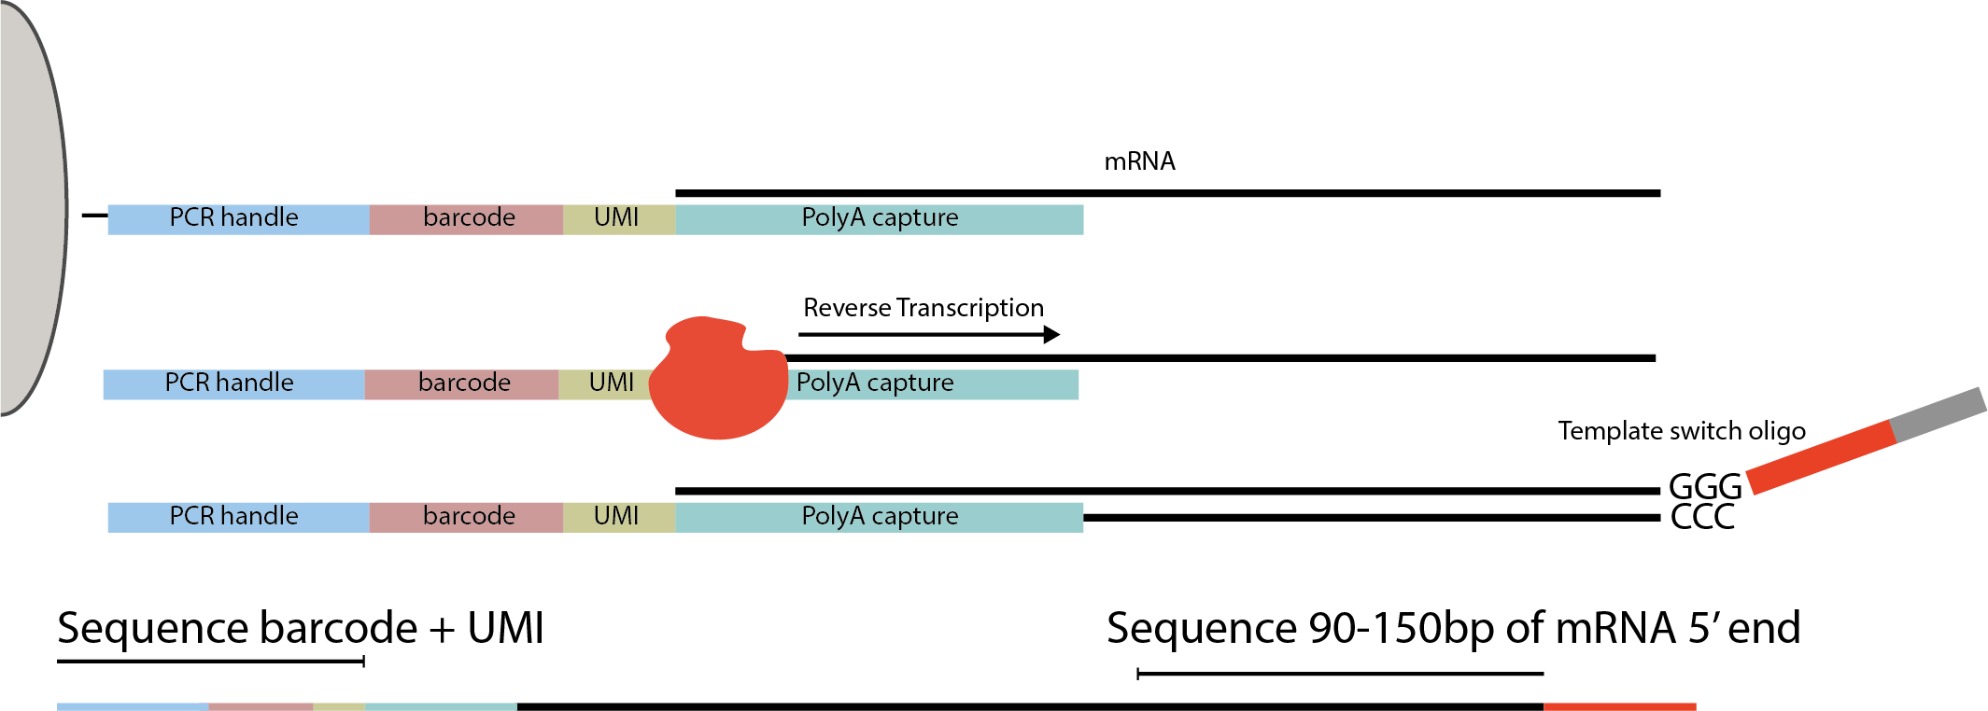
Short read single-cell sequencing
Short read sequencing only captures a fraction of the information from the mRNA.

Slide 23
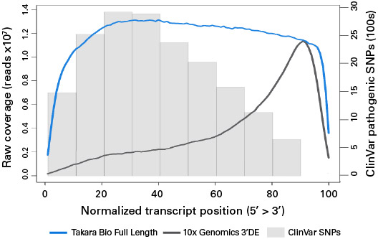
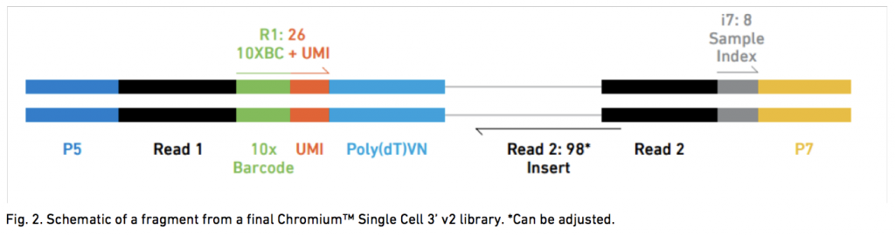
3’ tag counting with droplet-based methods

Slide 24
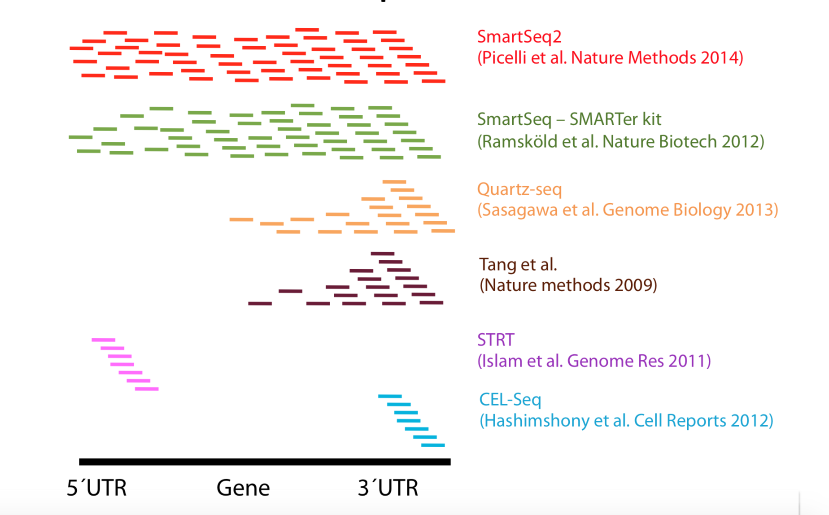
Bias associated with other methods

Slide 25
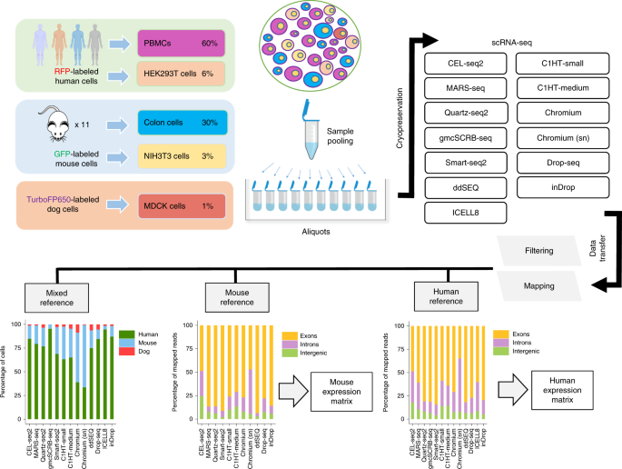
Which protocol do I use? Benchmarking studies
Ziegenhain et al. 2017, Mereu et al 2020

Slide 26
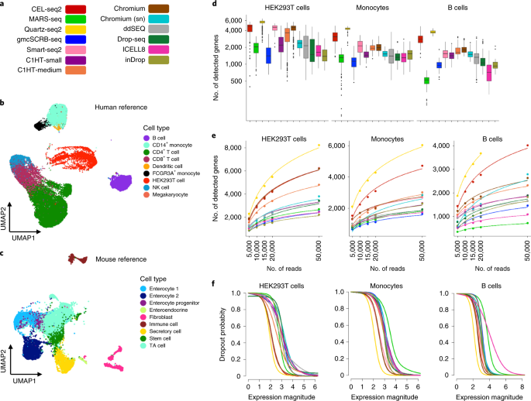
Which protocol do I use? Benchmarking studies
Mereu et al 2020

Slide 27
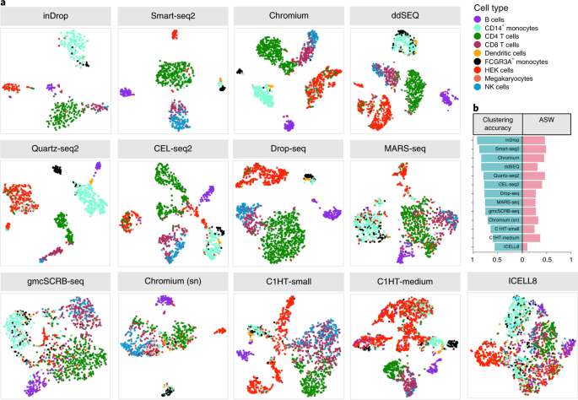
Which protocol do I use? Benchmarking studies
Mereu et al 2020

Slide 28
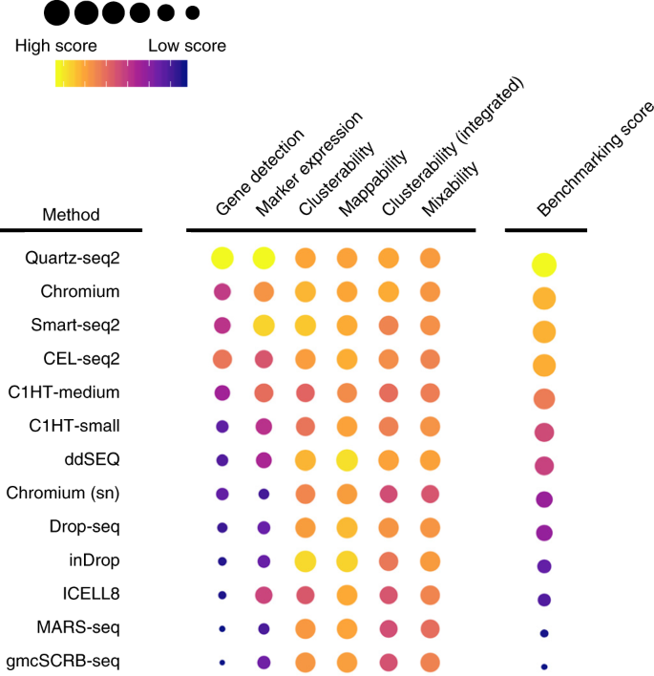
Which protocol do I use? Benchmarking studies

Slide 29
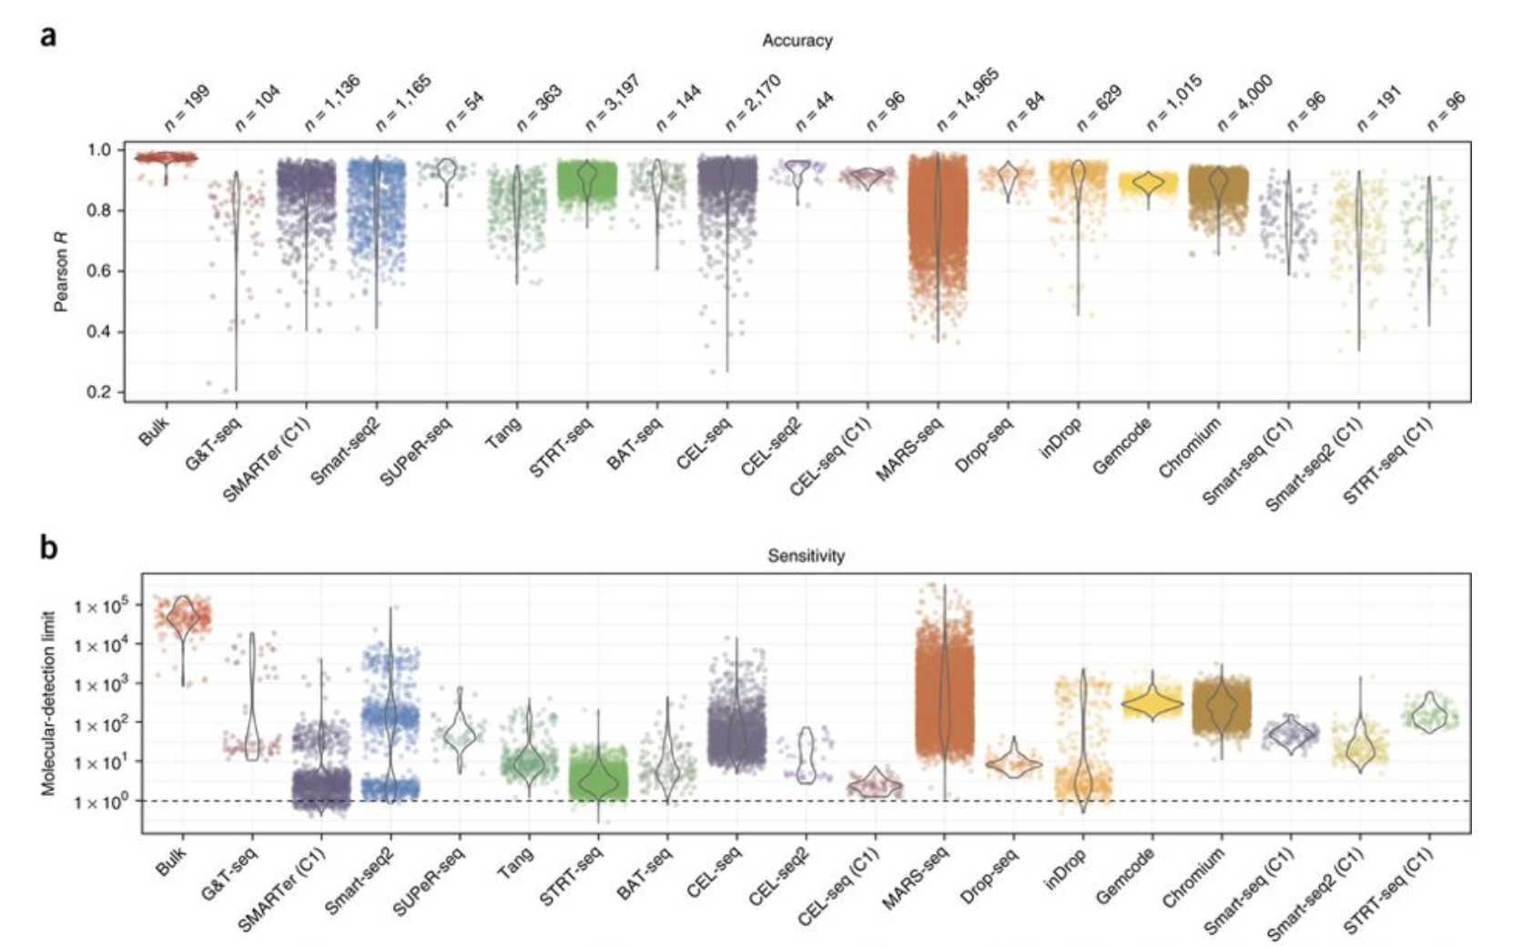
Different conclusions from different studies
Depends on the research question - depends on the cost – depends on the lab
Ziegenhain et al. 2017

Slide 30
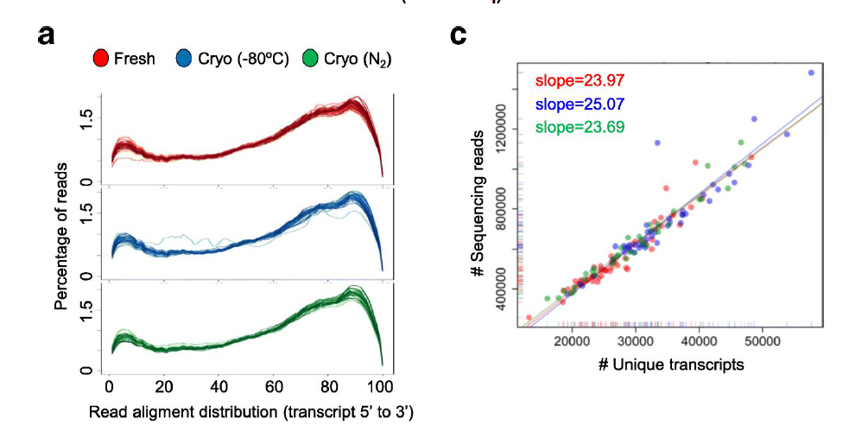
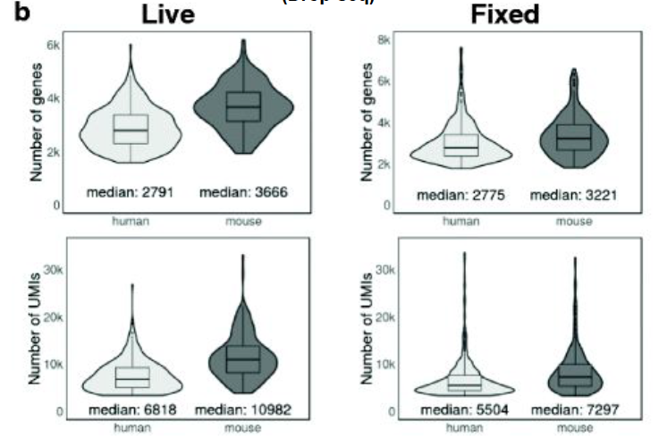
Fresh vs Frozen
Preservation circumvents the samples being collected at the same time
Minimises batch effect (greatest effect at library prep)
Freezing
Methanol fixation
Alles et al 2017
Guillaumet-Adkins et al 2017

Slide 31
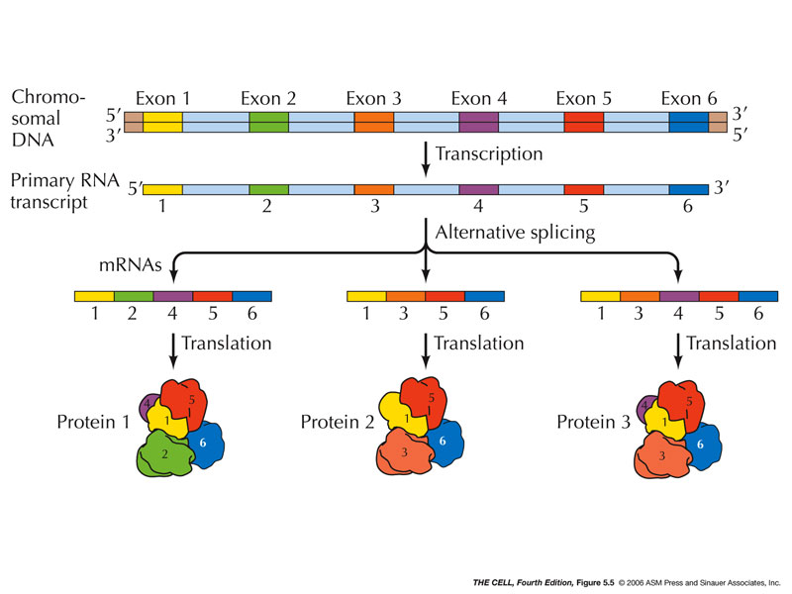
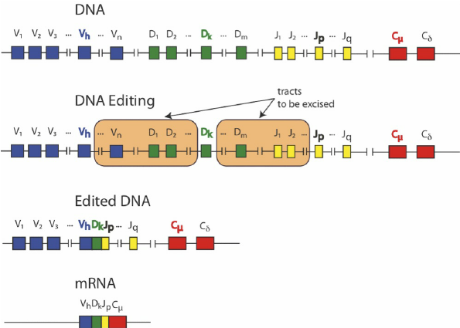
Long-read or short-read?
Alternative splicing
Why full length single-cell transcript sequencing is important
There are around 20,352 protein coding genes and a suspected 100,000 proteins.
Include antibody, B cell and T cell diversity then there are potentially millions of unique proteins
Long-read sequencing allows the full length of the mRNA to be measured
Isoform expression
Structural variation (CNV)
Variant calling
Translocations
B cell, T cell or immunoglobulin profiling
Recombination
Parisi et al 2011

Slide 32
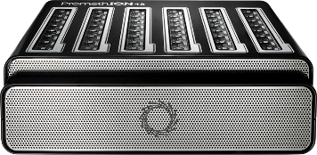
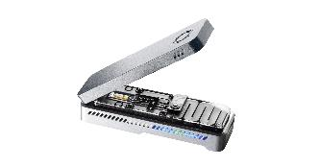
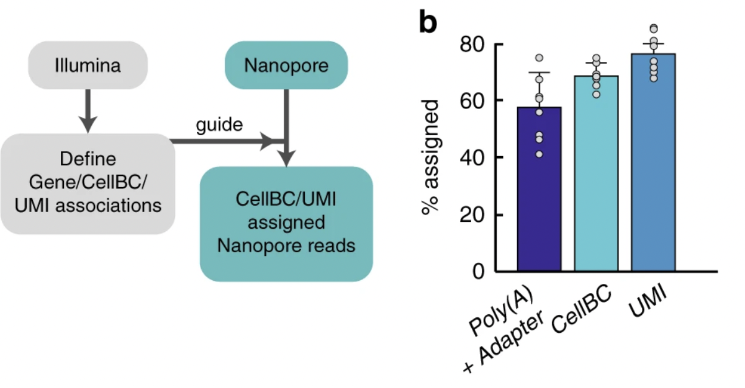
Problems with applying long-read to single-cell
Long-read sequencing is an emerging technology and holds promise as part of precision medicine tools
2 major systems- PacBio and Oxford Nanopore Technology
however…
Barcode and UMI need to be accurate
Nanopore sequencing has a high error rate- single-cell applications are challenging
PacBio: highly accurate, however not practical: current platform is not cost-effective (40 –120 cells at necessary sequencing depth)
Single-cell long-read technologies rely on short-read sequencing
Lebrigrand et al 2020 – can recover ~60% of reads
Barcodes assigned with high degree of accuracy
However, the UMI classification will be poor and actually not properly quantified in the manuscript

Slide 33
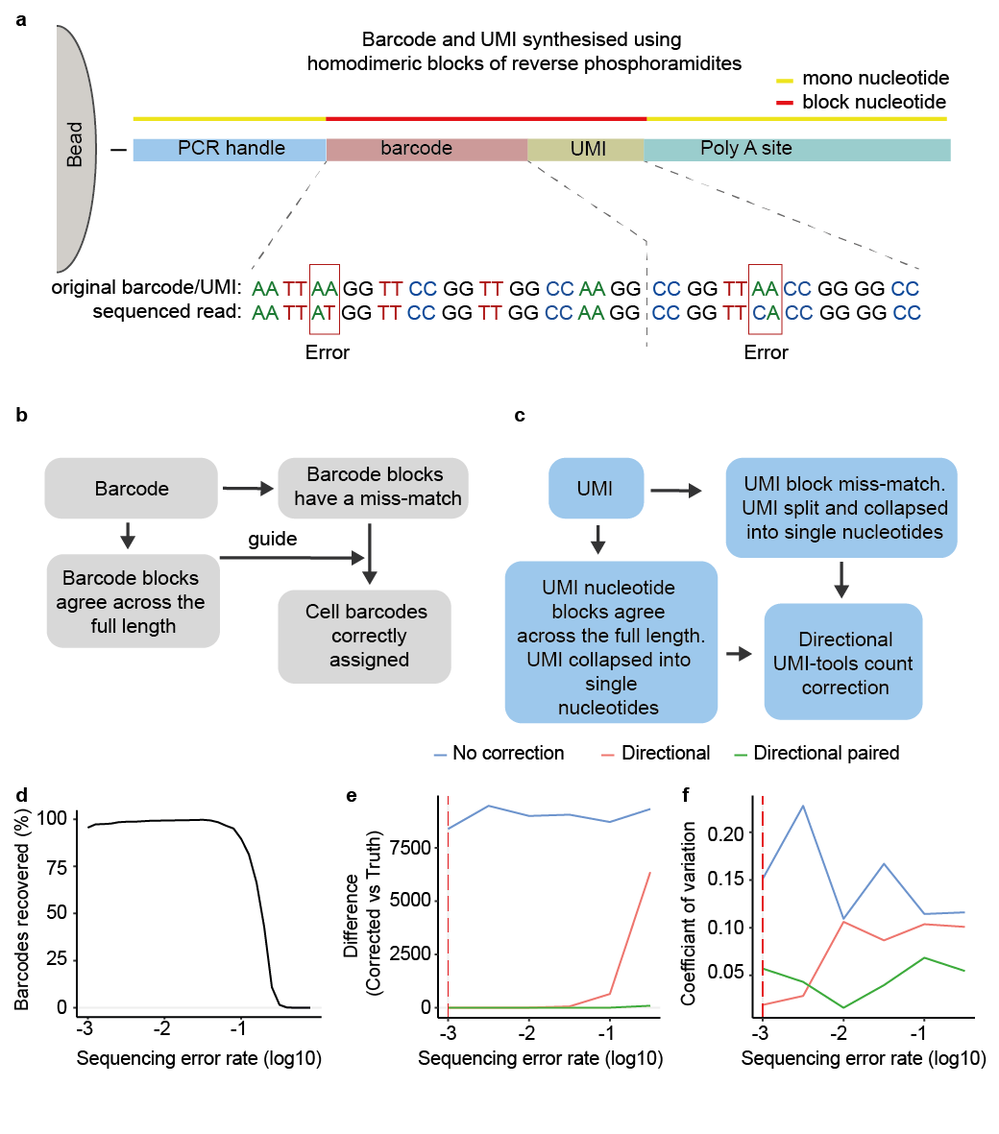
Error correcting nanopore single-cell sequencing
Build up our barcode and UMIs using blocks of nucleotides.
Dimer blocks allow us to pinpoint errors
Philpott M… Oppermann U, Cribbs AP. Nature biotech

Slide 34
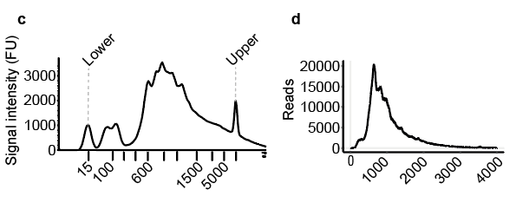
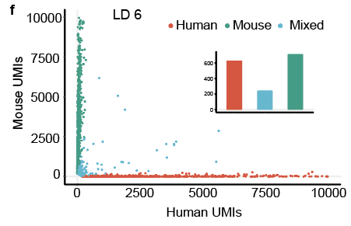
Droplet based direct long-read Nanopore sequencing scBUC-seq
Mixed species experiment shows high accurate read to cell assignment

Slide 35
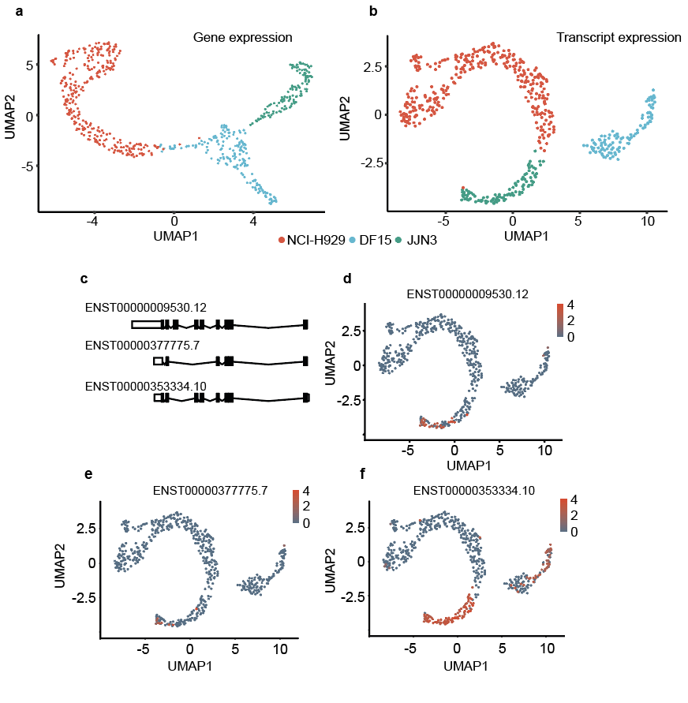
Direct long-read Nanopore sequencing
Using myeloma cell line mix we can effectively differentiate transcript usage
Example: HLA-DR

Slide 36
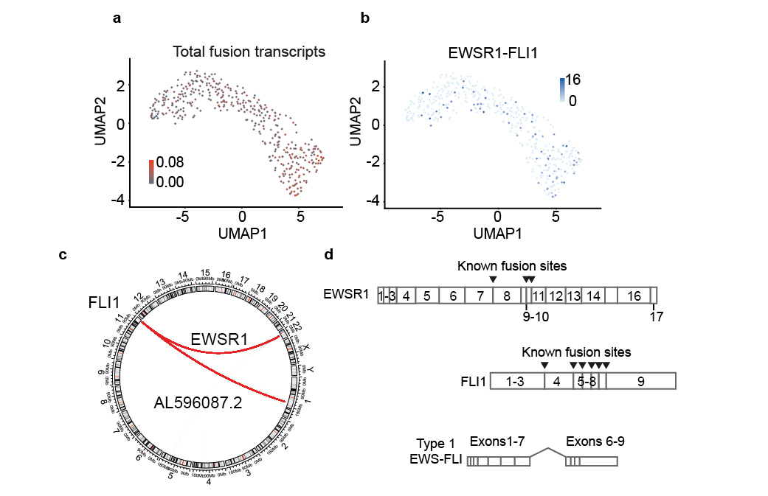
Direct long-read Nanopore sequencing
Measurement of fusion transcripts
Ewing’s sarcoma as a proof of principle
EWS-FLI fusion transcript
Can detect the presence of his fusion transcript in ~20% of cells
Detection of a novel fusion transcript between lncRNA

Slide 37
Multi-modal methods

Slide 38
CITE-seq

Slide 39
G&T-seq Genomic and transcriptomic

Slide 40
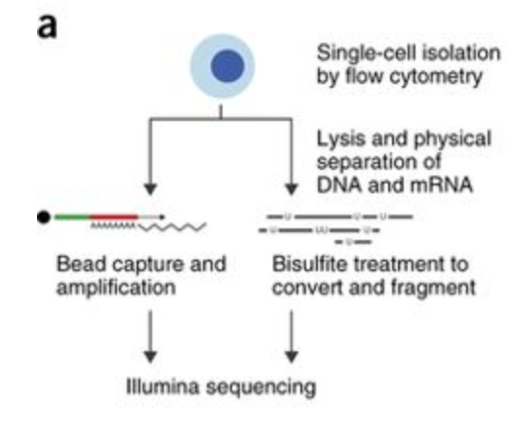
scM&T-seq methylation and transcriptomic

Slide 41
Spatial methods

Slide 42
Spatial transcriptomics (now part of 10X)

Slide 43
MERFISH

